Slide 1

Mike Millman IMPACT EMEA CPS

Slide 2
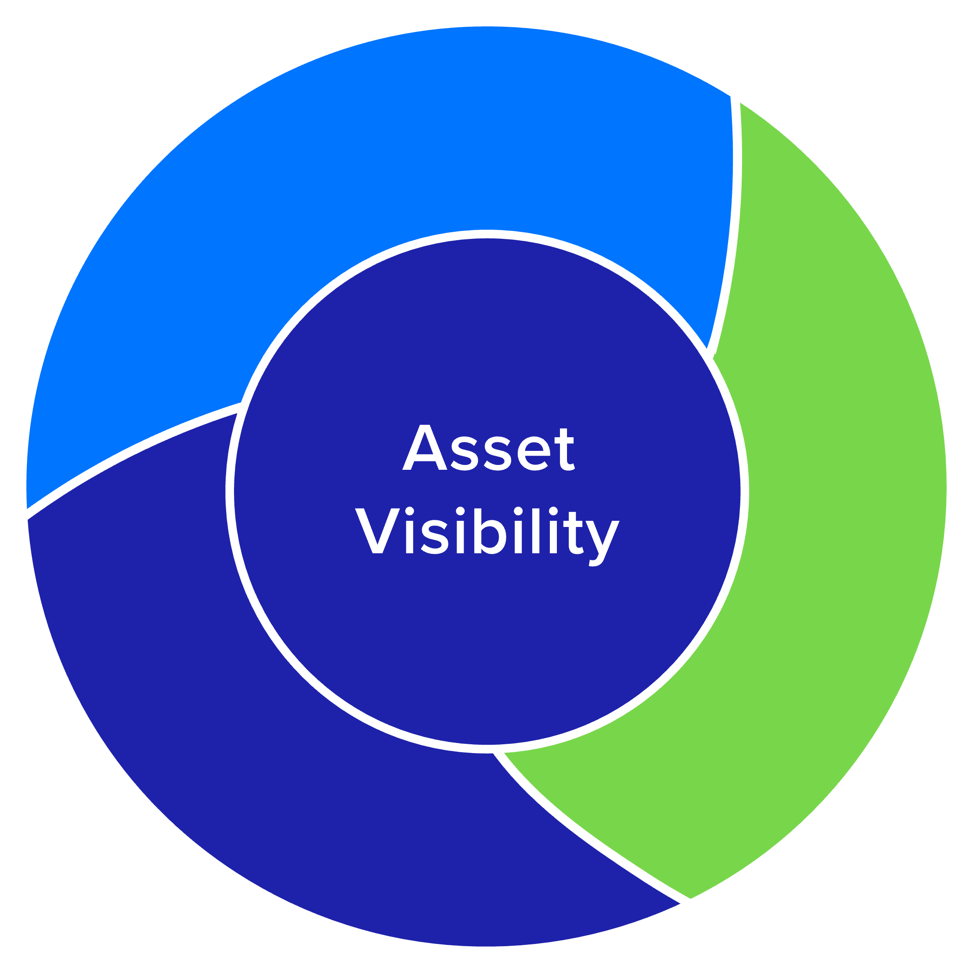
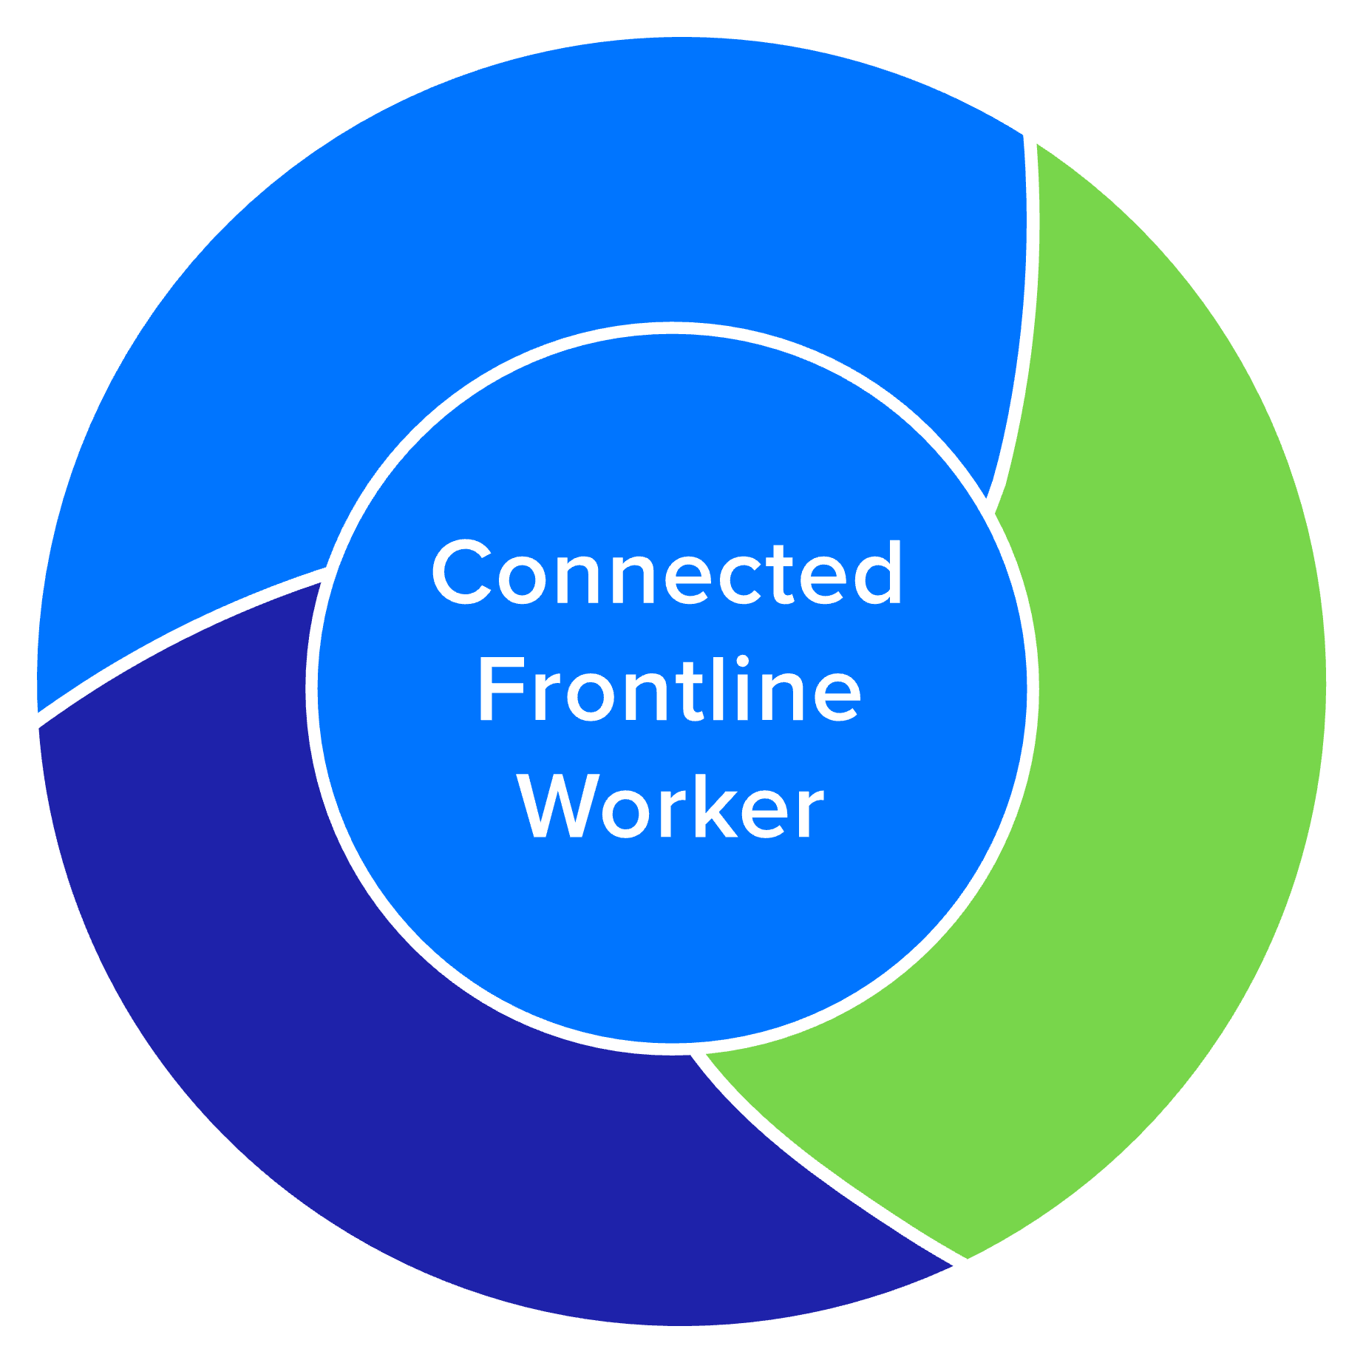
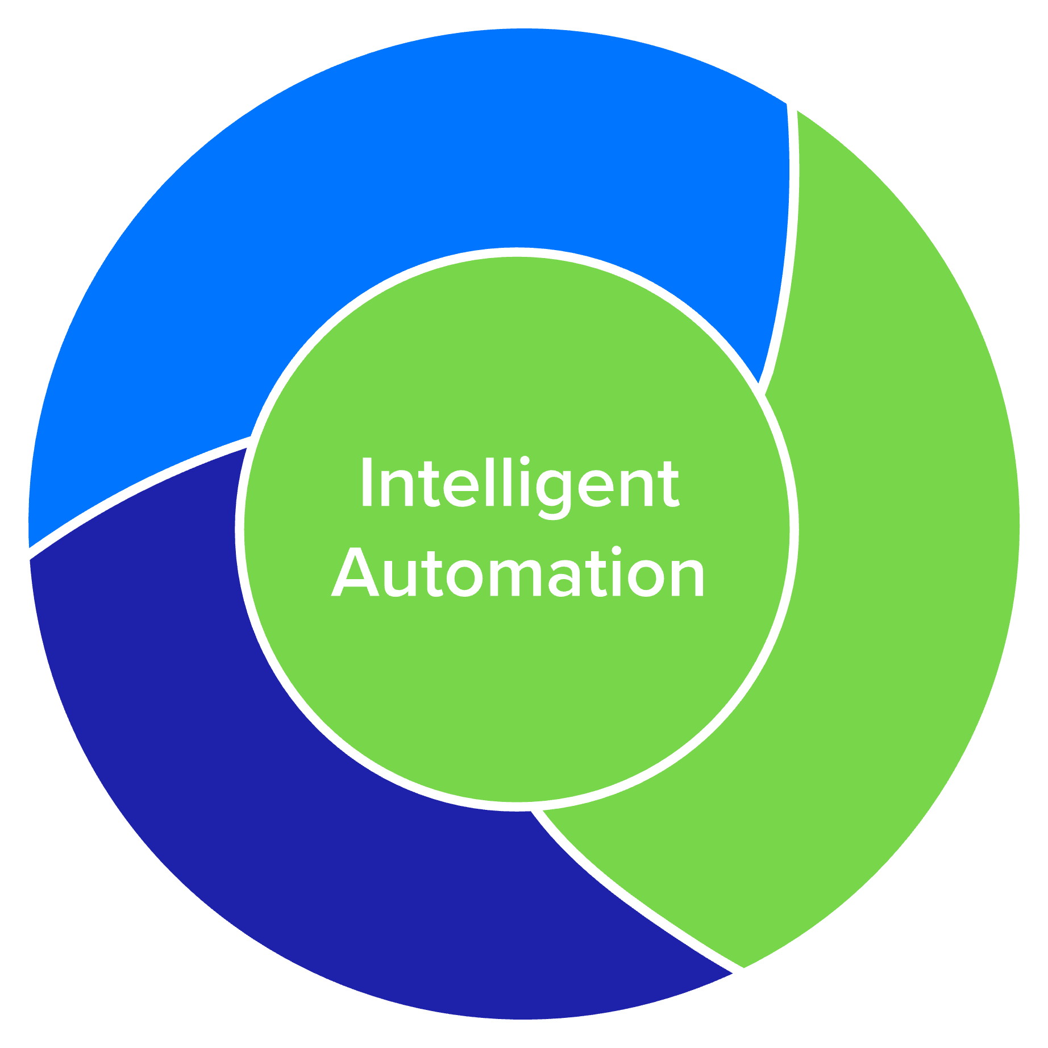

Slide 3


Asset Visibility
Aspiration
To enable businesses of all sizes to securely and uniquely track, monitor & manage what they and their customers value most - as they seek to improve business outcomes

Slide 4



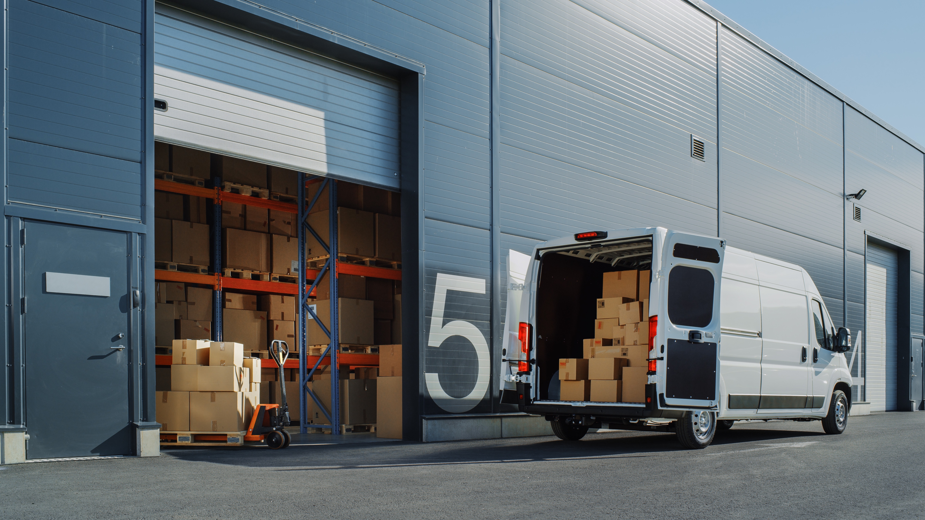

Simplified Ecosystem
Traceability System
Business User
Retail
Raw Material > Manufacturing
Logistics > Warehouse/ Distribution
Healthcare

Slide 5





Many Use Cases Are Showing Up In All Key Verticals
Asset Visibility
MFG
T&L / WH
Retail
Healthcare
Government
Food/ Pharma/ Retailer compliance
Inventory tagging/ reading in WH
Inventory Cycle Counting
Critical Asset Labeling
Military Asset Labeling
In-op tagging and reading
Portal reading at dock doors
Loss Detection
Patient ID/ Tracking
Inventory Management
POS/ Ticket Switching
Pharma Condition

Slide 6


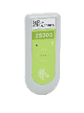
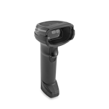

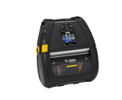
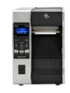
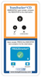
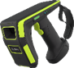
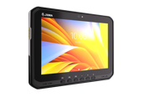
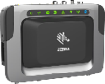
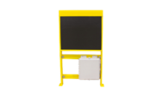
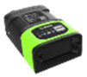
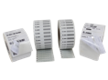
How Do We Address This Opportunity?
Partners
Zebra
Biz Consulting
Integration
Hosting
Warranty /
Repair
Services
Vertical Applications
Device Management Tools API’s
Dashboards
Software & Apps
Printers
Supplies & Sensors
Scanners / Readers
Handhelds
Fixed Readers / Portals
Vision

Slide 7


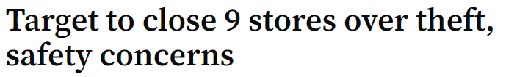



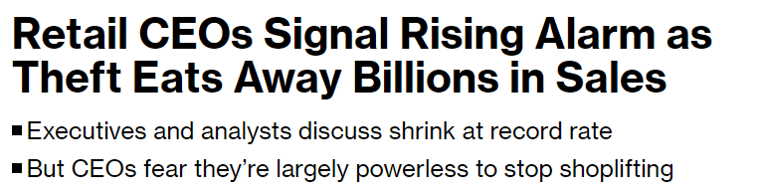
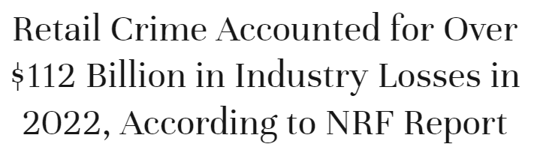
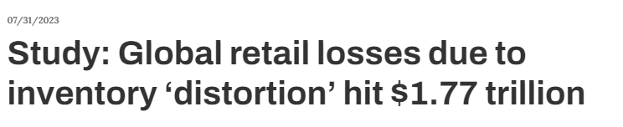


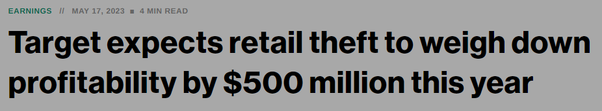
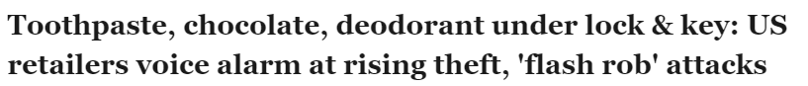


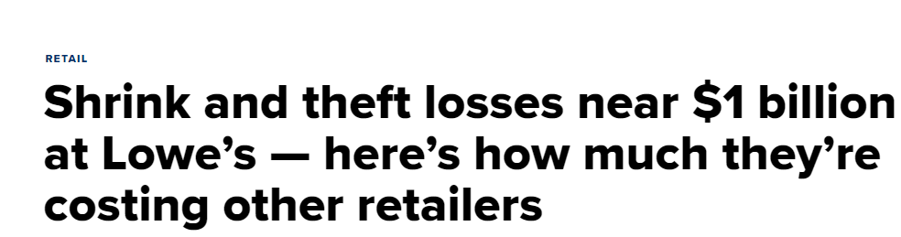


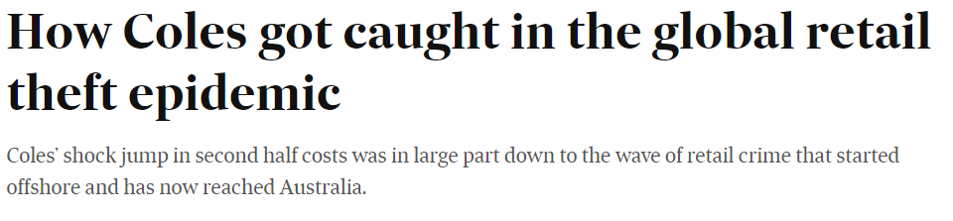

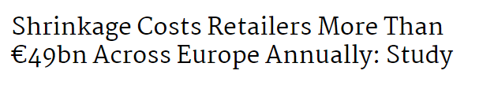


Slide 8
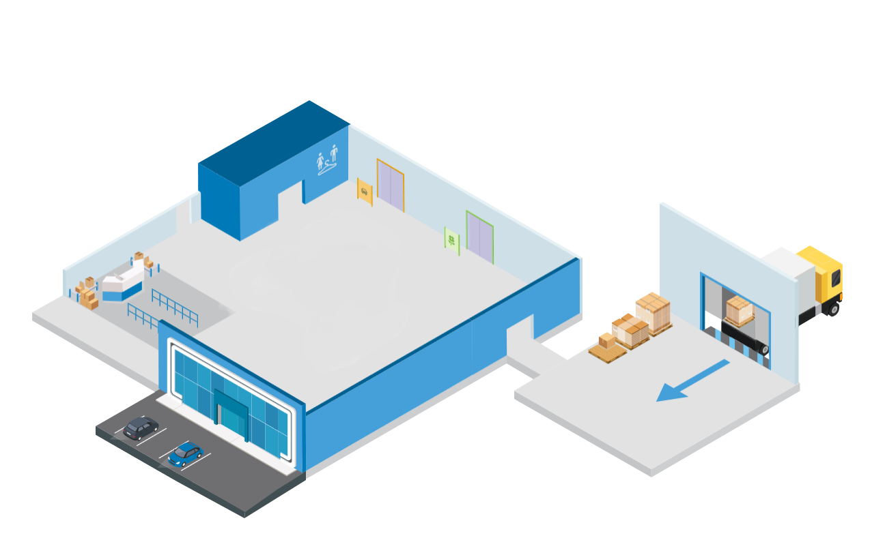
Visibility for a Mass Merchant
Fitting Room (Reader)
Auto Exit (Reader)
Employee Exit (Reader)
Garden Exit (Reader)
Online Fulfillment (Reader)
Receiving (Reader or Portals)
Back Room (Reader)
Customer Exit (Reader)

Slide 9


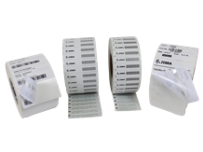
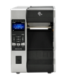

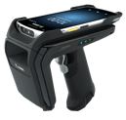
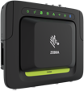
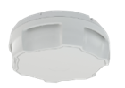
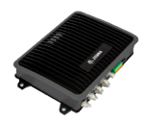
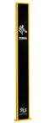
Loss Detection Solution Space
Physical installation
Integration with store inventory
Manufacturer source tagging
Transaction log reconciliation
Matching video with loss events, facial recognition, etc.
Building a case for law enforcement
Solution Partner Services
In a six week window… held conversations with
30% of the top 10 NRF retailers about the same exact solution (and two other Tier 1 retailers)
IoT Connector
Motionworks Enterprise
Tracking movement of tags through zones
Item serialization
Configuration & Location Analytics Software
Zebra Software & Apps
Zebra Hardware

Slide 10
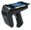
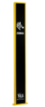
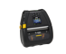
Visibility for a Mass Merchant
Fitting Room (Reader)
Auto Exit (Reader)
Employee Exit (Reader)
Garden Exit (Reader)
Online Fulfillment (Reader)
Receiving (Reader or Portals)
Back Room (Reader)
Customer Exit (Reader)

Slide 11
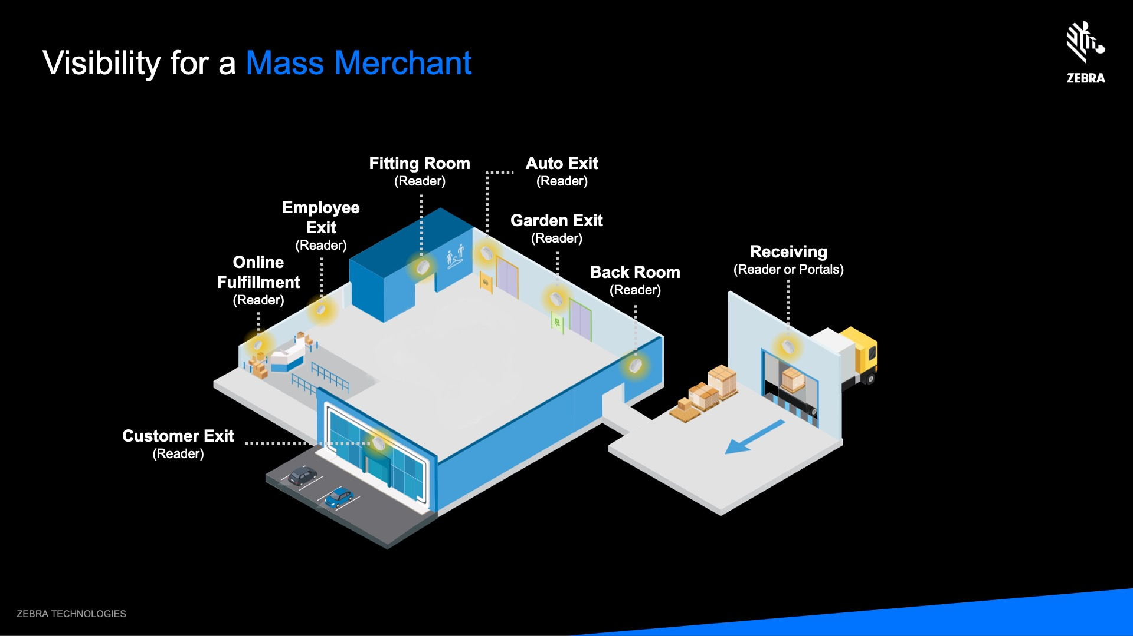
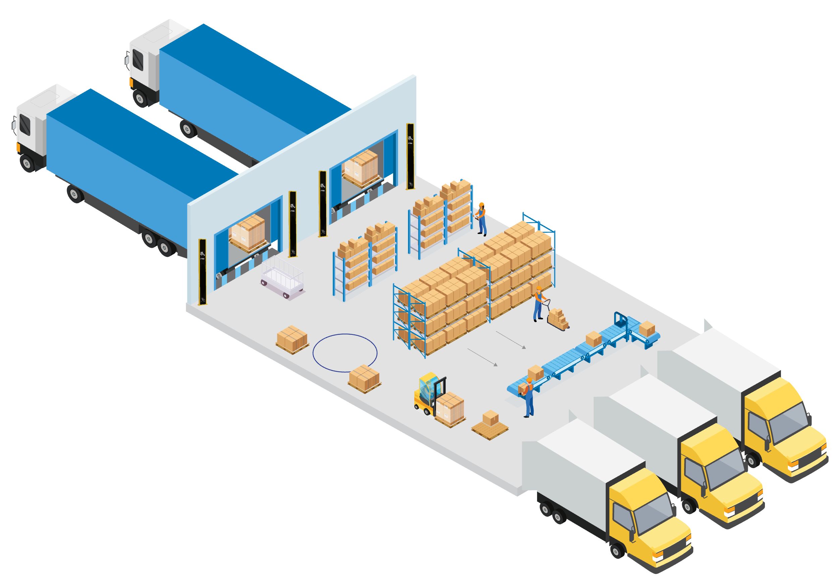
Visibility for a Parcel Depot
Inbound
Print & Tag Track Cages (and balance across sites)
Sort Keep inventory & locate undelivered parcels
Pre-Load Match right parcel to right truck
Outbound
Load Find parcel on truck
Special Holding / Staging (For customs, undelivered)

Slide 12
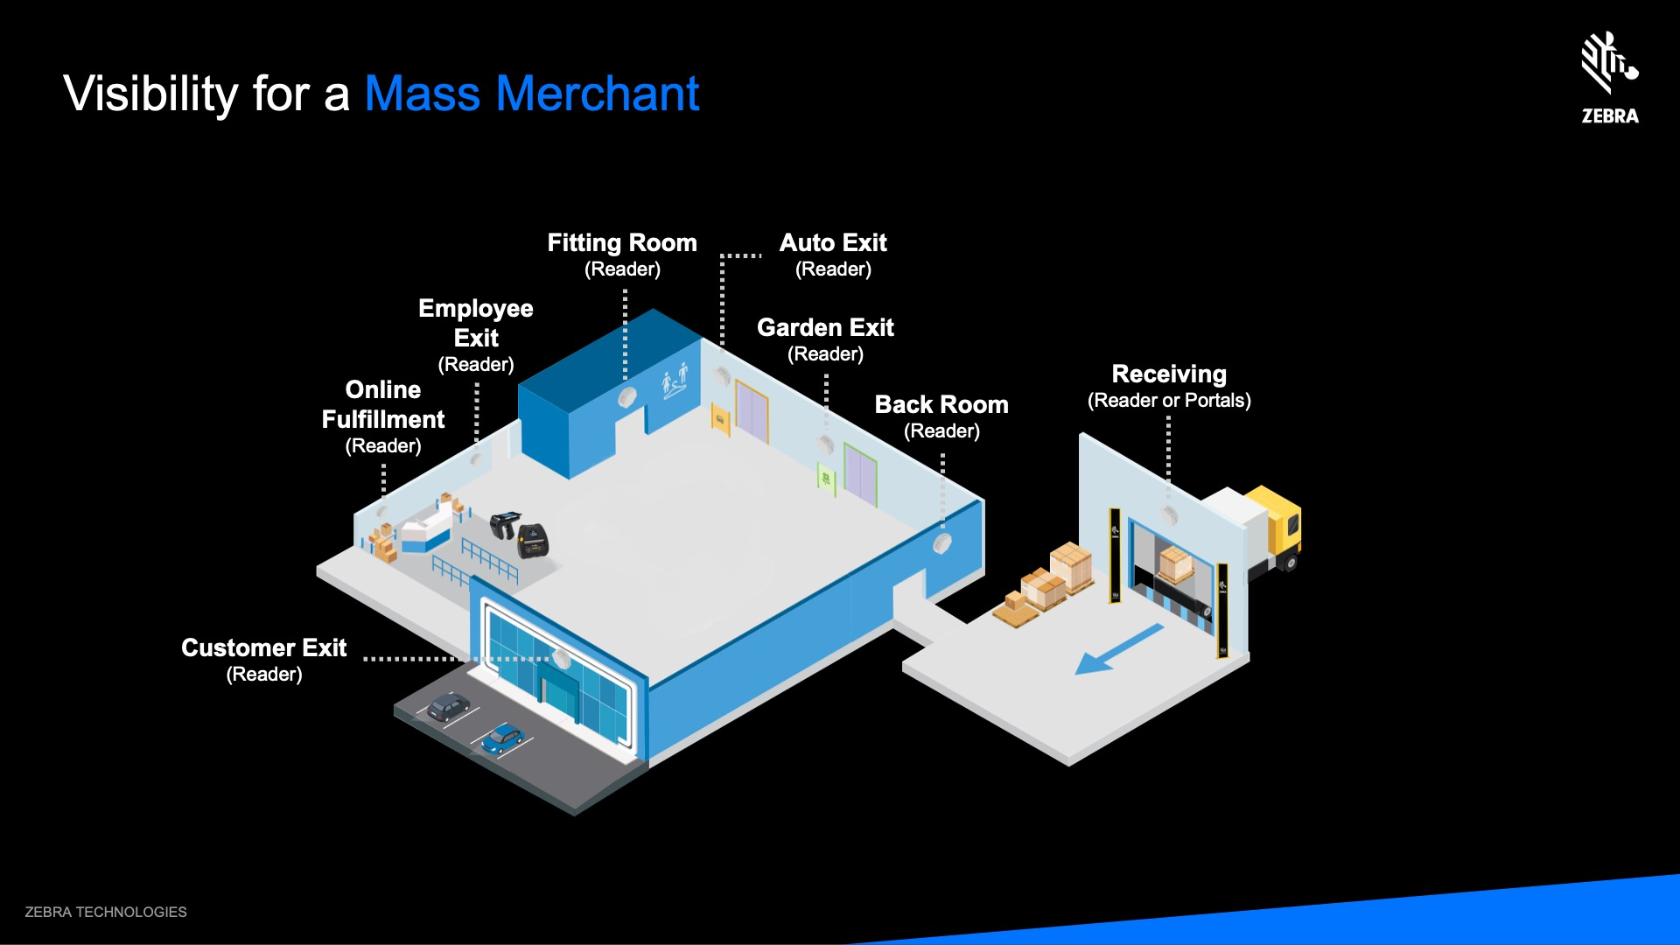
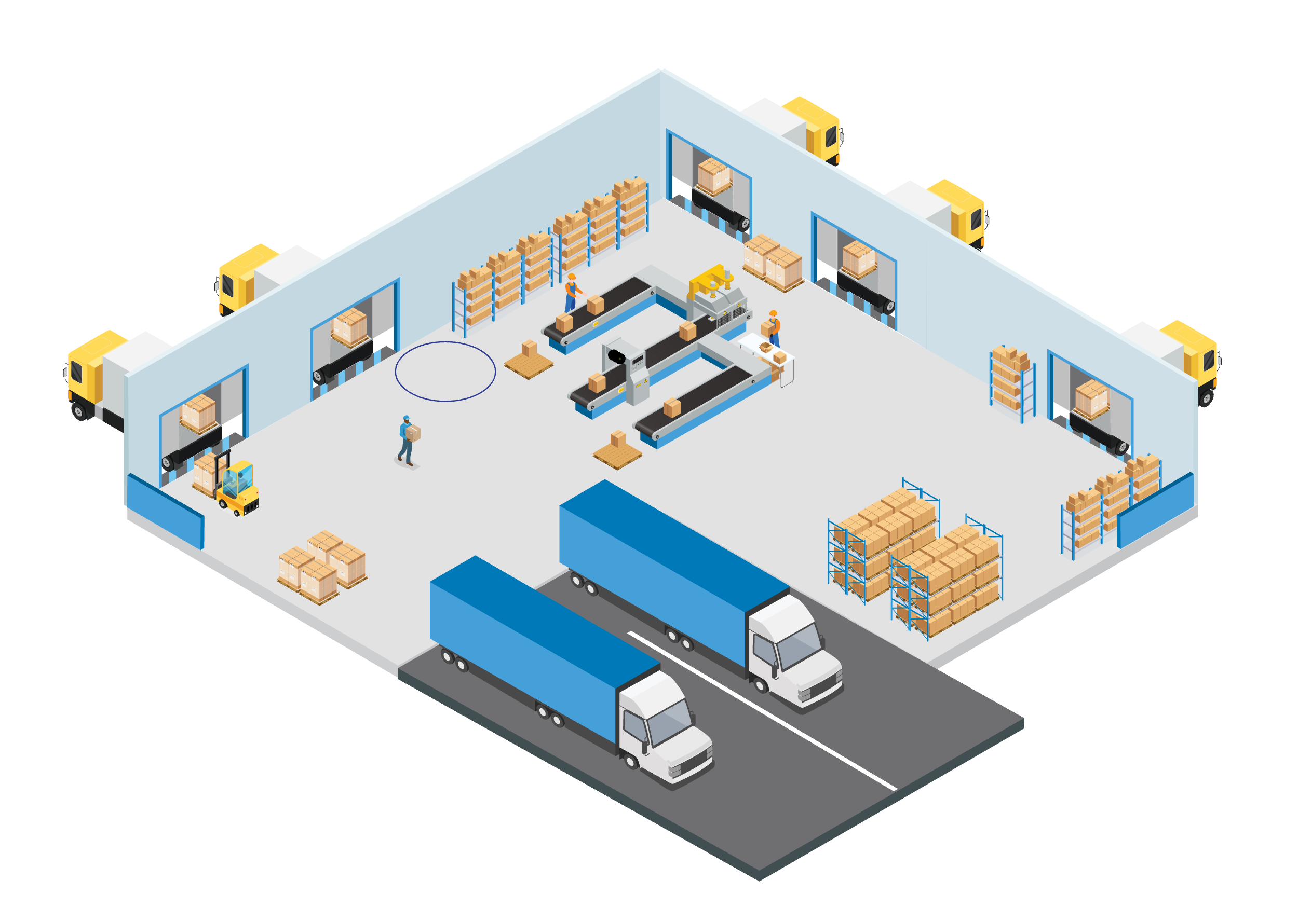
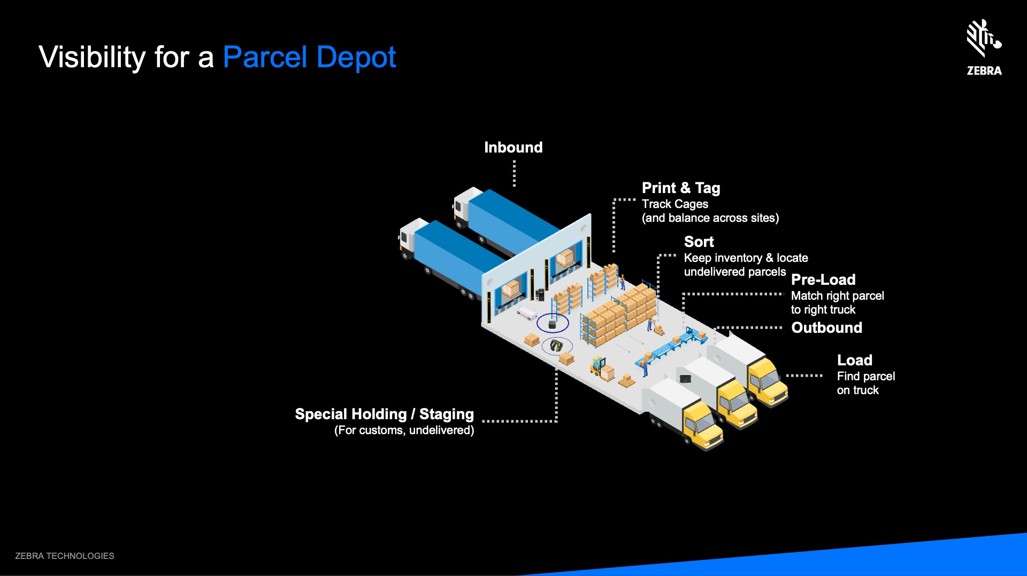
Control Points for a Manufacturing Plant
Station
Line Side Inventory
Receiving
Assembly Line
Print & Tag Items
Initial Product
Receiving
Shipping
Finished Good
Market Place Container Reads
Shipping Yard Enter / Exit
Shipping Finished Good

Slide 13
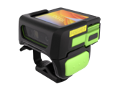
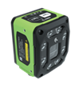
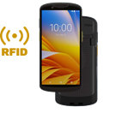
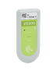
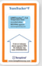
Different Verticals…Similar Story/ offers
Retail Loss Prevention
T&L Parcel Tracking
Manufacturing-Food Traceability
Physical installation
Physical installation
Physical installation
Software integration (inventory)
WMS integration
Inventory software
Manufacturer source tagging
TMS integration
Manufacturer source tagging
Transaction log reconciliation
Connecting item and package data
FSMA 204 compliance solutions – traceability back to source
Matching video with loss events
Tracking what’s inside the boxes…
Solution Partner Services
Building a case for law enforcement
Ecommerce
Recall management
Preventing grey market
IoT Connector
Motionworks Enterprise
Tracking movement of tags through zones
Item serialization
Configuration & Location Analytics Software
Zebra Software & Apps
Zebra Hardware

Slide 14
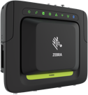

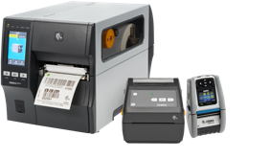
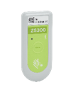





Hero Products to Feature in Asset Visibility Offers
Helping meet the needs of emerging mandates driving asset visibility adoption….
We have seen dramatic results in our ability to ensure product is available for our customers, leading to improved online order fulfillment and customer satisfaction.
EDSC = Efficient Digital Supply Chain
Digital Product Passport
FSMA 2.0
DSCSA
RFID was chosen because it’s stable, mature, and affordable
Shelly McDougal, Walmart’s Senior Director of Merchandising
Sue Fangman

Slide 15
We’re seeing deployments in many use cases/ verticals… The three we discussed are just higher adoption
Asset Visibility
MFG
T&L / WH
Retail
Healthcare
Government
Food/ Pharma/ Retailer compliance
Inventory tagging/ reading in WH
Inventory Cycle Counting
Critical Asset Labeling
Military Asset Labeling
In-op tagging and reading
Portal reading at dock doors
Loss Detection
Patient ID/ Tracking
Inventory Management
POS/ Ticket Switching
Pharma Condition

Slide 16




Key Takeaways
We need to jointly serve customers and win together!
Connect
Identify
Partner

